Slide 1


Slide 2

K-MEANS & FRIENDS
EXPLORING CLUSTERING WITH PHOTOGRAPHS
shaurya agarwal

Slide 3

Outline
motivation
movie
math
method
more

Slide 4
motivation
what are we talking about again?

Slide 5
quantization, clustering, k-means and friends
Image Compression, Customer Segmentation, Document Clustering, Anomaly Detection, Feature Learning and Dimensionality Reduction, Medical Imaging, Genomics and Bioinformatics, Speech Recognition, Astronomical Data Analysis, Pattern Recognition and Classification, even enabling efficient training for LLMs
…and unusually enough, a movie

Slide 6
movie
cinematography: a rather unusual use case for k-means

Slide 7

i got to do this
cinematography
on
a
budget
powered
by
python
Notes:
Eight Down Toofaan Mail (with English Subtitles): https://www.youtube.com/watch?v=VnHPtozfhRU

Slide 8
first principles
the best cinematography has exceptional control on color

Slide 9
first principles
showcase what inspired the film’s cinematography
Notes:
Some of the films that inspired the cinematography of “Eight Down Toofaan Mail”:
The Wishing Tree: https://film-grab.com/2019/08/10/the-wishing-tree/
Three Colours: White: https://film-grab.com/2014/09/16/three-colours-white/
Beauty and the Beast (1978): https://film-grab.com/2020/09/13/beauty-and-the-beast-1978/
The Colour of Pomegranates: https://film-grab.com/2019/05/09/the-colour-of-pomegranates/
The Rain People: https://film-grab.com/2023/04/11/the-rain-people/
The Passion of Anna: https://film-grab.com/2015/04/13/the-passion-of-anna/
After The Rehearsal: https://film-grab.com/2015/07/13/after-the-rehearsal/
Almanac of Fall: https://film-grab.com/2015/04/02/almanac-of-fall/

Slide 10
first principles - colors
one, or two or a few
Notes:
see this: https://www.youtube.com/watch?v=YCJXS4hvOsU

Slide 11
first principles - colors
one, or two or a few but no more

Slide 12
first principles - colors
the director ascribes meaning to these one, two or a few to tell the story

Slide 13
first principles - colors
these colors must remain (approximately, perceptually) consistent
throughout the process, across all devices and screens

Slide 14
pre-production
or else*
* I had a great director and a very very dedicated team, use your imagination

Slide 15
pre-production
there are expensive cameras and studio setup that offer great control over the process

Slide 16
pre-production
a typical day may cost 100s of 1000s of $$$ for camera and lighting

Slide 17
pre-production
but for a 10-day shoot, interior and exterior

Slide 18
pre-production
we had USD 359 total
(yes, that’s three hundred and fifty-nine dollars, at the current exchange rate)

Slide 19
key insight
light – waves – wavelength, wavelength, wavelength

Slide 20
key insight
light – colors – long wavelength, medium wavelength, short wavelength

Slide 21
how do you pick the colors?
I used k-means++ to do it
we’ll cover K-means first, the ++ is a way to better select the initial conditions, you’ll see

Slide 22
.
let’s see how
there really is no math to it...

Slide 23
math*
how clustering works

Slide 24

naïve explainer
imagine you have a bunch of marbles of different colors, and you want to organize them into groups

Slide 25

naïve explainer
the k-means method is like deciding to group the marbles
based on how close they are to each other (in color)

Slide 26
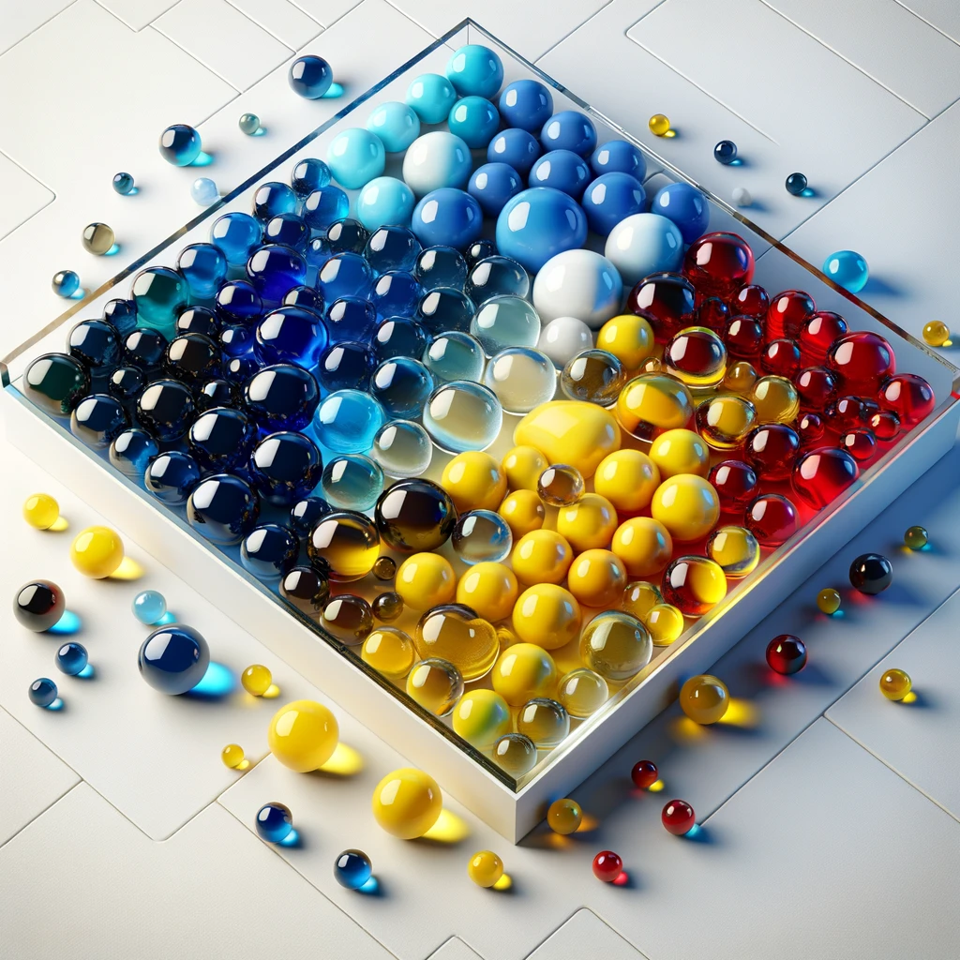

naïve explainer
the "k" in k-means is deciding how many groups you want

Slide 27
steps
Initialize
Assign
Update
Repeat

Slide 28
steps
Initialize
Start by selecting k initial centroids, where k is a predefined number of clusters
Initialize
Assign
Update
Repeat

Slide 29
steps
Assign
each data point to the closest centroid, creating clusters.
Initialize
Assign
Update
Repeat
“distance” is how you find the closest centroid, define distance to mean the unit measure of the feature(s) you cluster on

Slide 30
steps
Update
Recalculate the centroids as the mean of all points in each cluster
Initialize
Assign
Update
Repeat

Slide 31
steps
Repeat
the assignment and update steps until the centroids no longer change significantly, indicating convergence
Initialize
Assign
Update
Repeat

Slide 32
steps
Limit
Often the centroids do not seem to converge, but dance around the convergence points, this is when we stop the algorithm by specifying the maximum number of iterations
Initialize
Assign
Update
Repeat
Limit

Slide 33
framework
Representation
Distance Measure
K

Slide 34
framework
Representation
feature comes in focus
unit distances mean the same thing everywhere.
Representation
Distance Measure
K
Notes:
Examples from other domains:
When clustering customers, ensure they are using the same currency
When clustering time related data, ensure everything relates to the same time zone (or UTC)
When clustering colors, we need a model where the colors are perceptually equidistant, this is not the case for RGB, this is the case for CIELab* or CIELUV

Slide 35
framework
Distance Measure
Cartesian, Manhattan, Cosine or custom based on the feature(s) you want to use to create the clusters.
Representation
Distance Measure
K
Notes:
Consider the following heuristic to select if we should use the Cartesian distance or the Manhattan distance (this is just a sample to get you going, of course based on the domain and what you are looking for there will be other aspects of the evaluation rubric):
Feature Scaling Sensitivity
Cartesian Distance: Highly influenced by differences in the scale of features. If one feature has a much larger range of values than others, it can dominate the distance calculation.
Manhattan Distance: Less sensitive to scaling discrepancies. It gives equal weight to changes in each dimension (feature), mitigating dominance by large-scale features.
Example: Clustering customers based on both age and annual income. If income isn't normalized, its vast differences may overwhelm the impact of age differences. Manhattan distance would make clustering less biased towards income.
High-Dimensional Data with Sparse Features
Cartesian Distance in High Dimensions: Loses its geometric interpretation, becoming less intuitive. Differences are spread across many dimensions, potentially diluting the "closeness" signal.
Manhattan Distance with Sparse Features: Focuses on the dimensions where changes actually occur. If features are mostly zeros, Manhattan distance considers only the dimensions where the data points differ, potentially leading to more meaningful clusters.
Example: Clustering text documents based on word occurrence. Documents are high-dimensional (many word features), and most words don't occur in a given document (sparse). Manhattan distance focuses on the co-occurrence of words, rather than overall "geometric" distance in a high-dimensional space.
Ordinal Features
Cartesian Distance: Assumes that the magnitude of difference along a dimension is meaningful on a continuous scale.
Manhattan Distance: Handles ordinal features (e.g., survey ratings: bad, neutral, good) where relative differences between values are meaningful, but not the exact numeric distance.
Prioritizing Feature Independence
Cartesian Distance: Considers interaction between features (e.g., a change in x and y coordinates together has a larger effect than the sum of their individual changes).
Manhattan Distance: Treats each dimension independently. This can be valuable when you want to find clusters where changes in one feature don't necessarily strongly imply changes in another.

Slide 36
framework
The Right K: Elbow Method
Plot the cost (e.g., within-cluster sum of squares) against different k values. The "elbow" point, where the rate of decrease sharply changes, can indicate a good k value.
Representation
Distance Measure
K

Slide 37
framework
The Right K: Silhouette Score
Measure how similar an object is to its own cluster compared to other clusters. A high silhouette score suggests the object is well matched to its own cluster and poorly matched to neighboring clusters. The k that maximizes the average silhouette score may be chosen.
Representation
Distance Measure
K

Slide 38
framework
The Right K: Gap Statistic
Compares the total within intra-cluster variation for different values of k with their expected values under null reference distribution of the data. The k with the highest gap statistic suggests the optimal clustering.
Representation
Distance Measure
K

Slide 39
how?
let’s see this in action

Slide 40
method
let’s look at some code

Slide 41
tech stack
this is compute intensive
we leverage vectorized, just-in-time approach

Slide 42
tech stack
JAX parallelizes and optimizes the compute DAG over NumPy

Slide 43
code
switch to code
notebook: kandinsky/02-K-Means-and-friends.ipynb

Slide 44

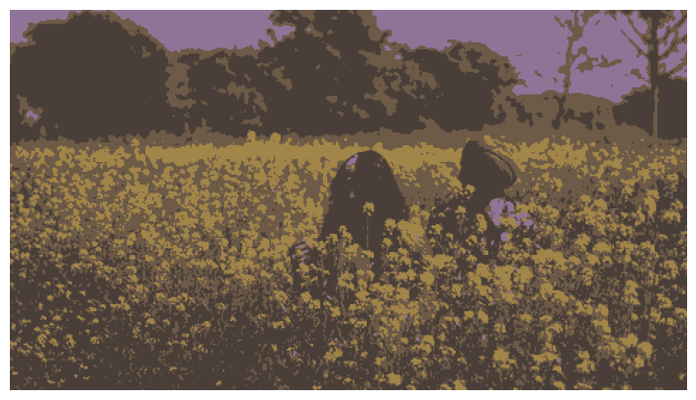
results

Slide 45


results

Slide 46

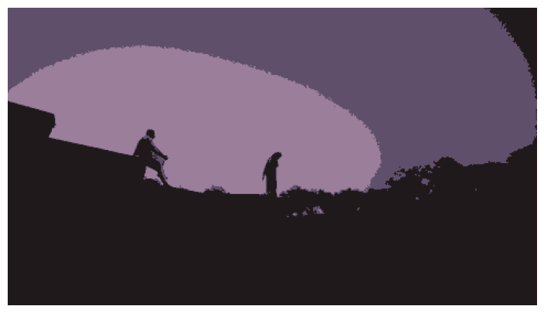
results

Slide 47

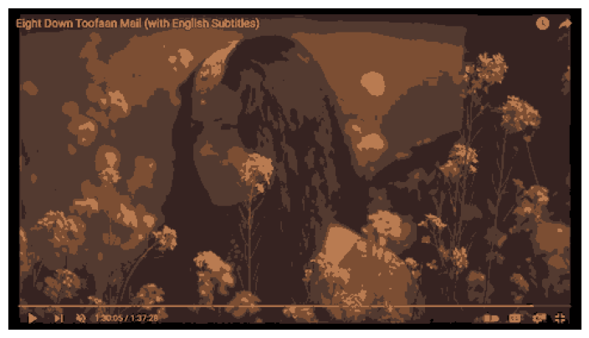
results

Slide 48
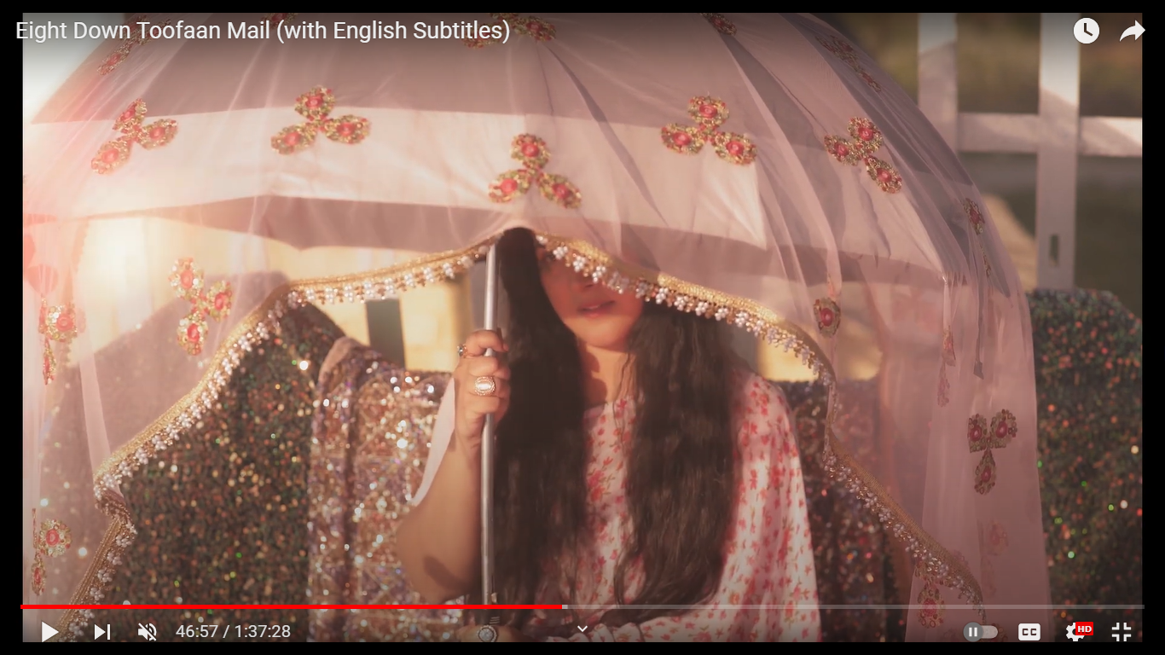
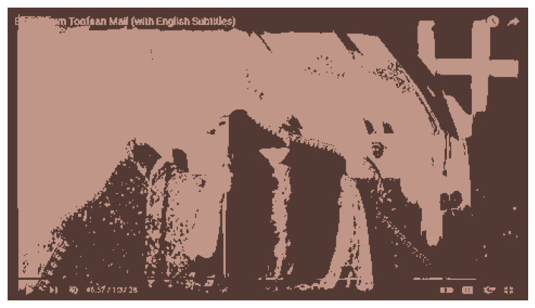
results

Slide 49
MORE
JOIN THE DISCUSSION, GITHUB, MAKE THIS BETTER

Slide 50
open-source
Eight Down Toofaan Mail
is now on YouTube https://www.youtube.com/watch?v=VnHPtozfhRU
this project on GitHub: https://github.com/shauryashaurya/kandinsky
join me

